Slide 1


Tkinter GUI

Slide 2

Overview
BeautifulSoup
Tkinter
Graphical User Interfaces
https://docs.python.org/3.8/library/tkinter.html

Slide 3
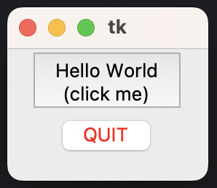

Introducting TK and Tkinter
import tkinter as tk class Application(tk.Frame): def __init__(self, master=None): super().__init__(master) self.master = master self.pack() self.create_widgets() def create_widgets(self): self.hi_there = tk.Button(self) self.hi_there["text"] = "Hello World\n(click me)" self.hi_there["command"] = self.say_hi self.hi_there.pack(side="top") self.quit = tk.Button(self, text="QUIT", fg="red", command=self.master.destroy) self.quit.pack(side="bottom") def say_hi(self): print("hi there, everyone!") root = tk.Tk() app = Application(master=root) app.mainloop()
Tk widget library originates from the Tool Command Language (Tcl) programming language
Tcl and Tk were created by John Ousterhout at Berkeley in the ‘80s
Easier way to program the engineering tools being used at the university on Unix systems
Tkinter is a Python interface to the Tk GUI library and has been a part of the Python standard library since 1994

Slide 4
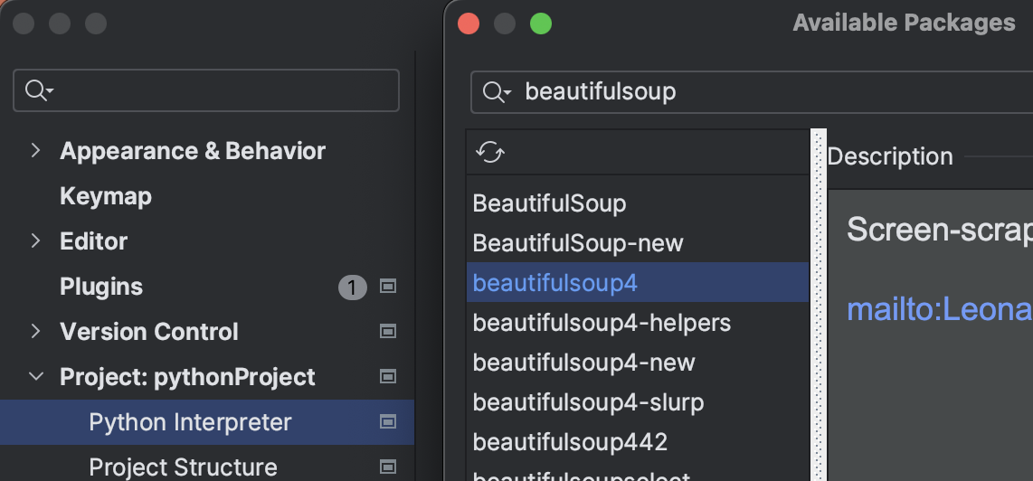
Website Scraper with Beautifulsoup
Beautiful Soup is a Python library for pulling data out of HTML and XML files with a parser
From CLI
pip install beautifulsoup4
https://www.crummy.com/software/BeautifulSoup/bs4/doc/

Slide 5
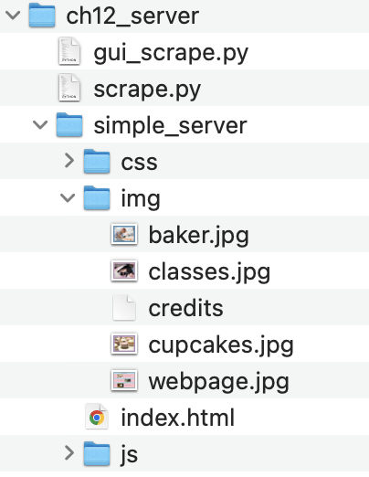
Create a directory for Web Server
Directory will emulate a web site directory on a public server
Web site will include hyper text markup language (HTML)
The html will refer to images that can be ‘scraped’
Use the python web server to create local server
<div class="container-fluid"> <div class="image"> <img src="img/cupcakes.jpg" alt="rows of cupcakes" class="img-fluid"> </div> <div class="text">

Slide 6
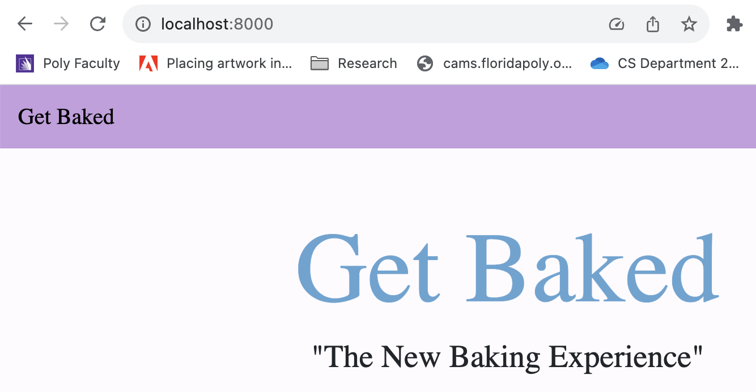
Run python server command
Server must be started from the same directory path as the index.html
python -m http.server 8000
Then open a browser at localhost:8000
You can right-click on the page and select View Page Source

Slide 7
Create scrape.py
Import the following modules
Parse the arguments with argparse
Need the base64 library to save the images within a JSON file
Need to open files for writing (using pathlib).
BeautifulSoup for scraping the web page
Use requests to fetch its content with http get or post
# scrape.py
import argparse
import base64
import json
from pathlib import Path
from bs4 import BeautifulSoup
import requests

Slide 8
Check for installed library module
Run the following command to check if installed
Mac –
pip freeze | egrep -i "soup4|requests"
beautifulsoup4==4.9.3
requests==2.26.0
Windows=
pip freeze | findstr soup4
pip freeze | findstr requests

Slide 9
Building scraper.py
if __name__ == "__main__": parser = argparse.ArgumentParser( description='Scrape a webpage.') parser.add_argument( '-t', '--type', choices=['all', 'png', 'jpg'], default='all', help='The image type we want to scrape.') parser.add_argument( '-f', '--format', choices=['img', 'json'], default='img', help='The format images are saved to.') parser.add_argument( 'url', help='The URL we want to scrape for images.') args = parser.parse_args() scrape(args.url, args.format, args.type)
If__name causes module to only be run when you run the script directly, as its __name__
Define the parser from standard library module, argparse
Feed our script:
types of images you want to save,
format in which we want to save them,
URL of the page to be scraped.
The types can be PNGs, JPGs, or both (the default option), while the format can be either image or JSON, image being the default.
URL is mandatory argument.
https://docs.python.org/3/library/argparse.html

Slide 10
Building scraper.py
if __name__ == "__main__": parser = argparse.ArgumentParser( description='Scrape a webpage.') parser.add_argument( '-t', '--type', choices=['all', 'png', 'jpg'], default='all', help='The image type we want to scrape.') parser.add_argument( '-f', '--format', choices=['img', 'json'], default='img', help='The format images are saved to.') parser.add_argument( 'url', help='The URL we want to scrape for images.') args = parser.parse_args() scrape(args.url, args.format, args.type)
If__name causes module to only be run when you run the script directly, as its __name__
Define the parser from standard library module, argparse
Feed our script:
types of images you want to save,
format in which we want to save them,
URL of the page to be scraped.
The types can be PNGs, JPGs, or both (the default option), while the format can be either image or JSON, image being the default.
URL is mandatory argument.
https://docs.python.org/3/library/argparse.html

Slide 11
Building scraper.py
if __name__ == "__main__": parser = argparse.ArgumentParser( description='Scrape a webpage.') parser.add_argument( '-t', '--type', choices=['all', 'png', 'jpg'], default='all', help='The image type we want to scrape.') parser.add_argument( '-f', '--format', choices=['img', 'json'], default='img', help='The format images are saved to.') parser.add_argument( 'url', help='The URL we want to scrape for images.') args = parser.parse_args() scrape(args.url, args.format, args.type)
Add the -t option, allowing also the long version, --type. The choices are 'all', 'png', and 'jpg’.
Set the default to 'all' and add a help message.
For the format argument, allowing both the short and long syntax (-f and --format)
Add the url argument, which is the only one that is specified differently so that it won't be treated as an option, but rather as a positional argument.
To parse all the arguments, need parser.parse_args()
Call the scrape() function, passing all the arguments parsed.
You can call argparse by passing -h, it will print usage text for you automatically
python scrape.py -h
https://docs.python.org/3/library/argparse.html

Slide 12
Building scraper.py
if __name__ == "__main__": parser = argparse.ArgumentParser( description='Scrape a webpage.') parser.add_argument( '-t', '--type', choices=['all', 'png', 'jpg'], default='all', help='The image type we want to scrape.') parser.add_argument( '-f', '--format', choices=['img', 'json'], default='img', help='The format images are saved to.') parser.add_argument( 'url', help='The URL we want to scrape for images.') args = parser.parse_args() scrape(args.url, args.format, args.type)
Add the -t option, allowing also the long version, --type. The choices are 'all', 'png', and 'jpg’.
Set the default to 'all' and add a help message.
For the format argument, allowing both the short and long syntax (-f and --format)
Add the url argument, which is the only one that is specified differently so that it won't be treated as an option, but rather as a positional argument.
To parse all the arguments, need parser.parse_args()
Call the scrape() function, passing all the arguments parsed.
You can call argparse by passing -h, it will print usage text for you automatically
python scrape.py -h
https://docs.python.org/3/library/argparse.html

Slide 13

To run the program
python scrape.py http://localhost:8000
python scrape.py -t png http://localhost:8000
python scrape.py –t jpg -f json http://localhost:8000

